Slide 1
Project C
Ethical Hacking
Daniel Yeoell

Slide 2
Executive Summary
After successfully installing a network upgrade for my company’s client, I have been asked to perform another cybersecurity service. My client hired a consultant to install and configure a new server in their internal network to support production and operations. I was tasked with determining the vulnerabilities of the new Production server and providing specific examples of how any vulnerabilities could be exploited. Lastly, I was also asked to perform the same service on the Webserver in their DMZ.

Slide 3
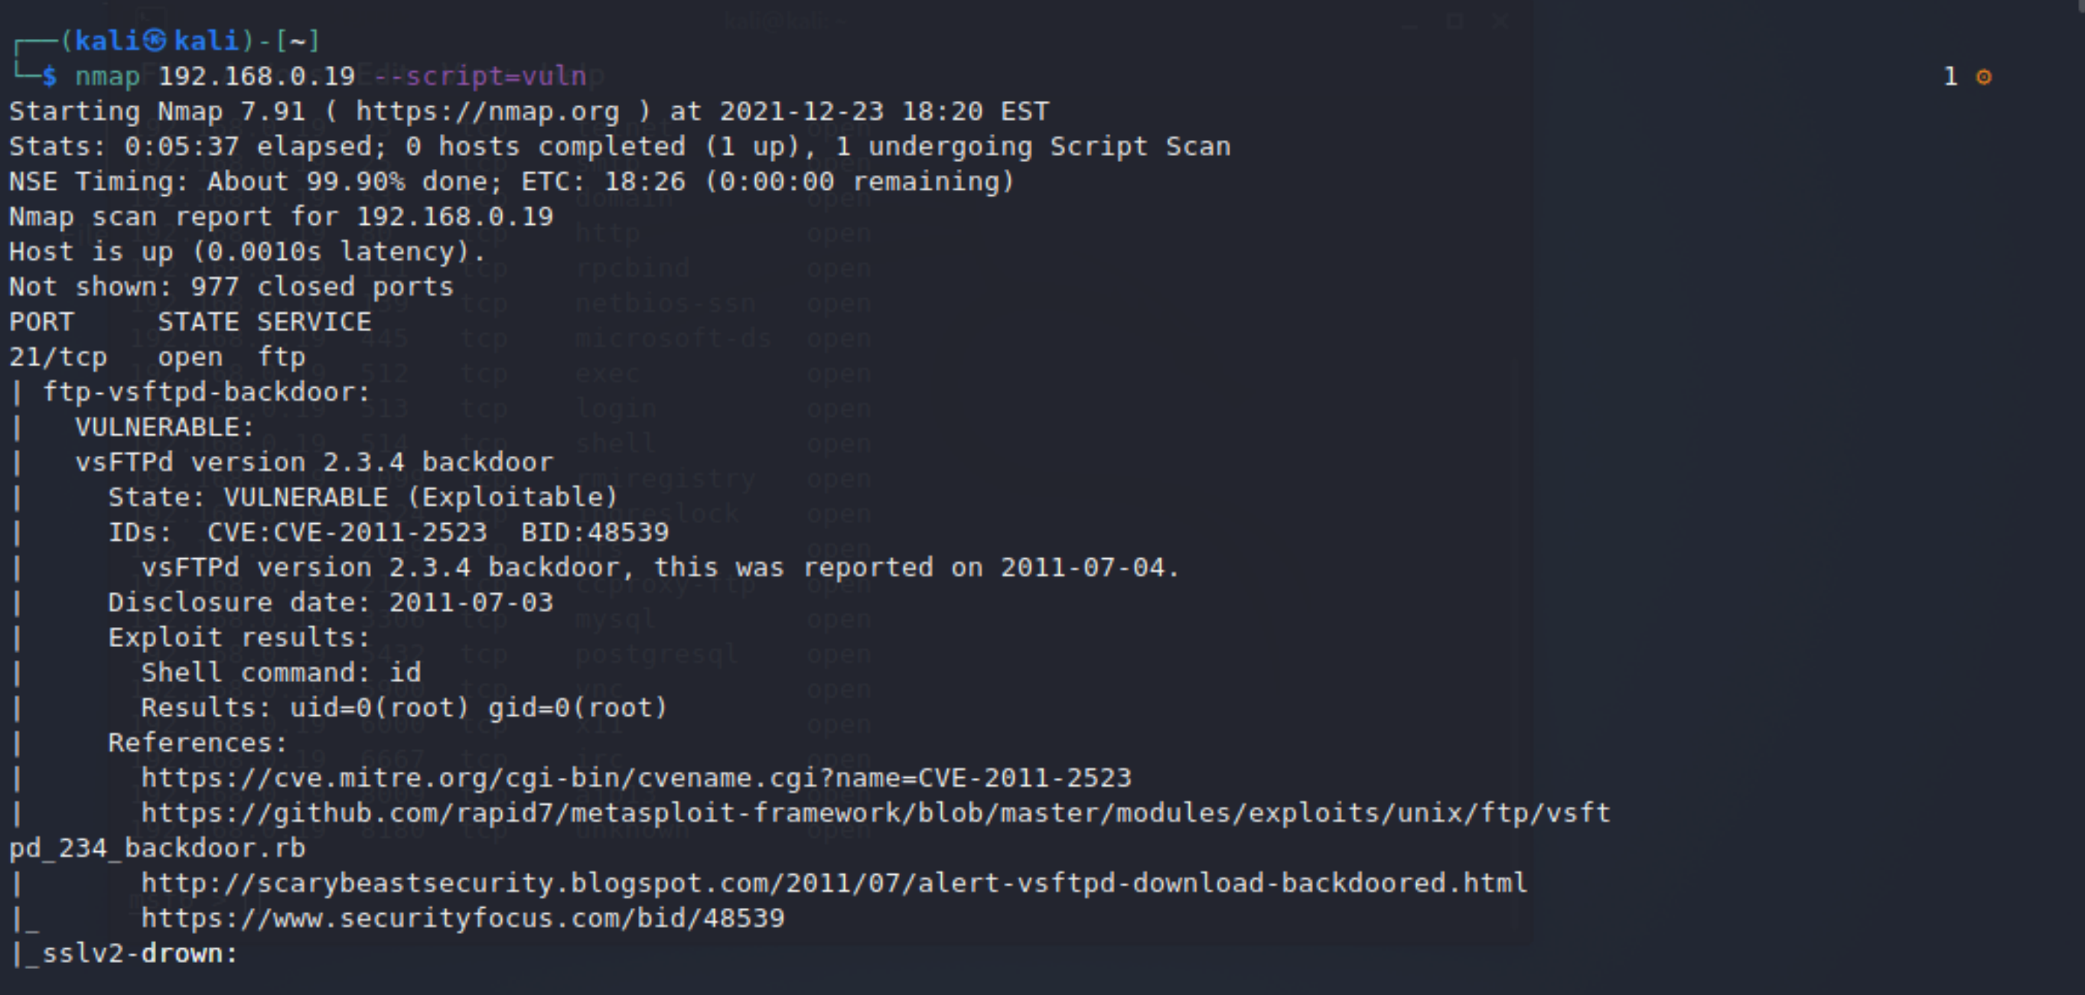
Vulnerabilities found on Production Server

Slide 4
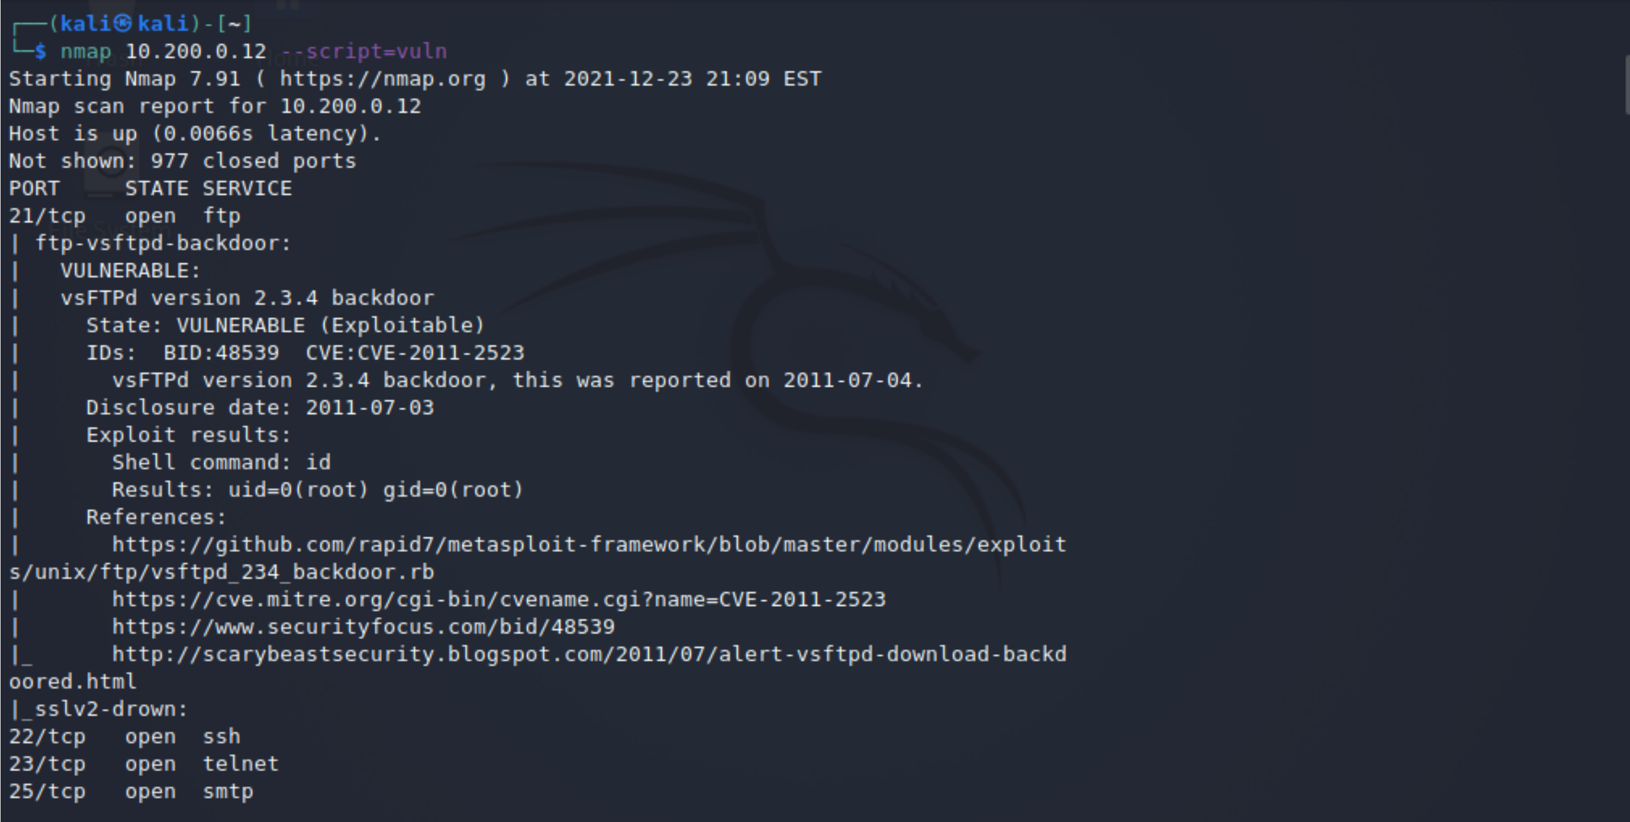
Vulnerabilities found on the Web Server

Slide 5
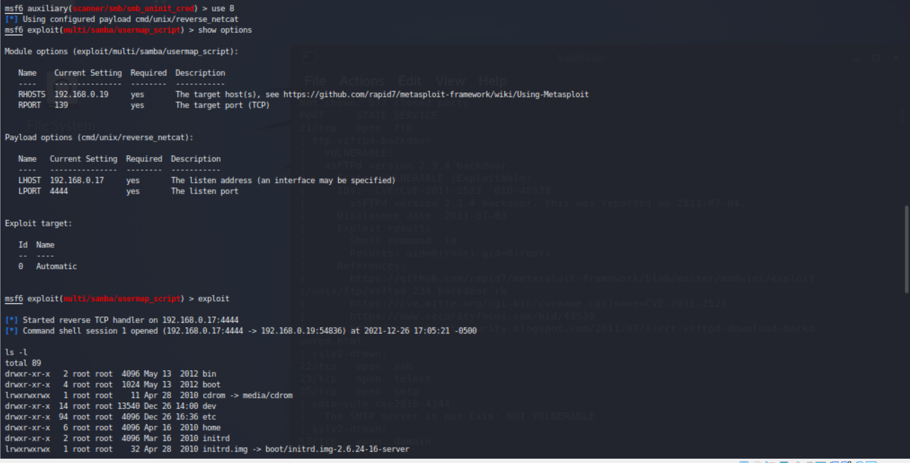
Exploit 1 on Production Server

Slide 6
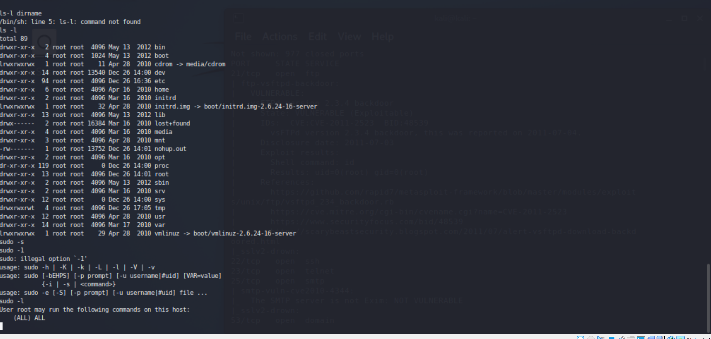
Exploit 1 with Root Permission

Slide 7
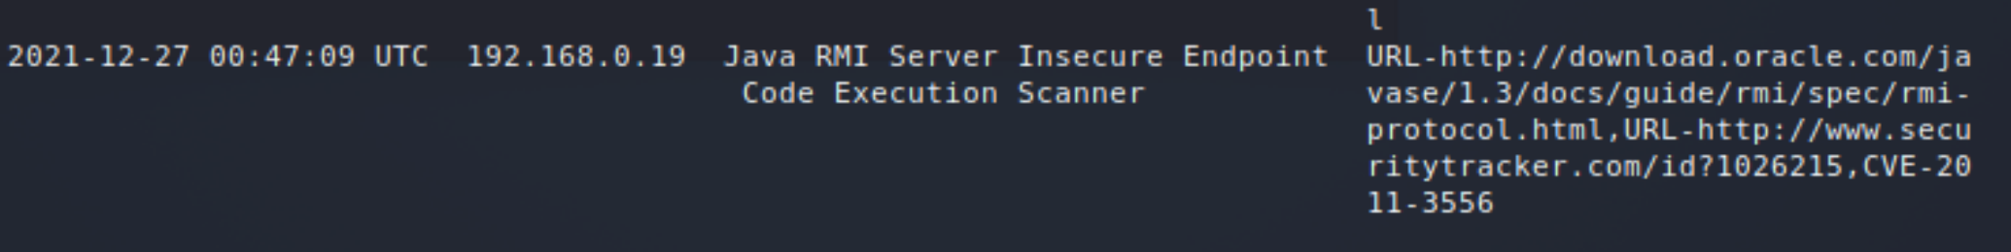
Exploit 2 on Production Server

Slide 8
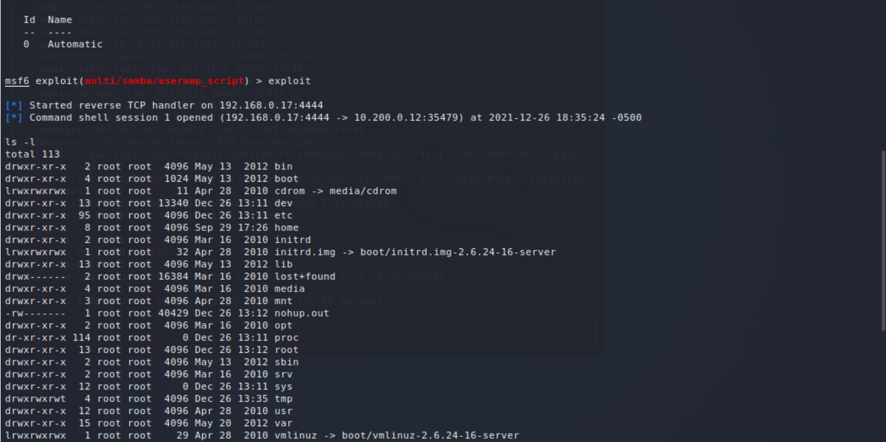
Exploit 1 on Web Server

Slide 9
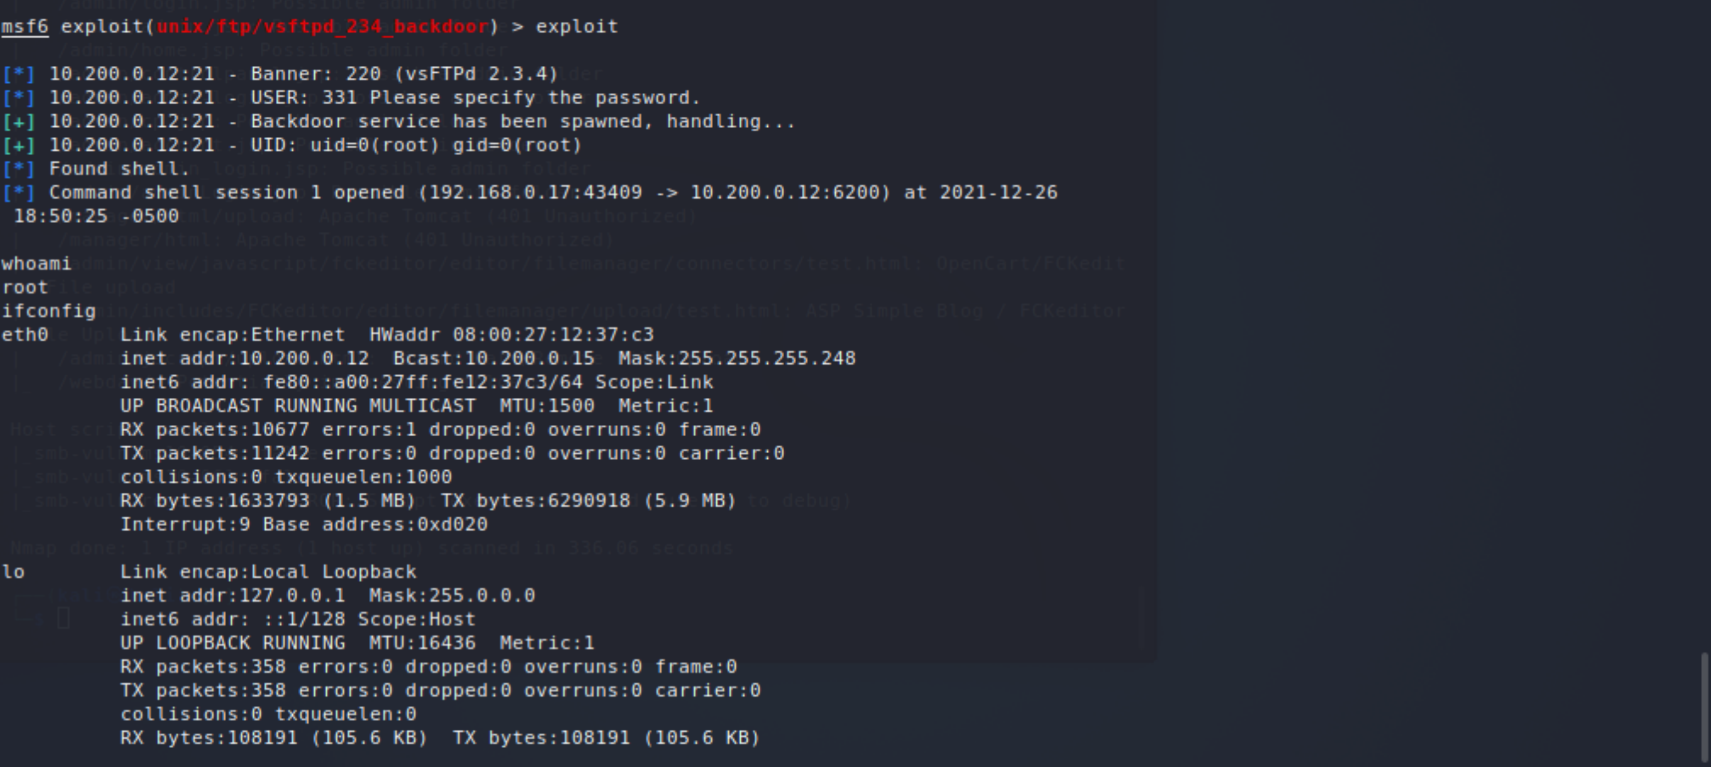
Exploit 2 with Root Permission

Slide 10
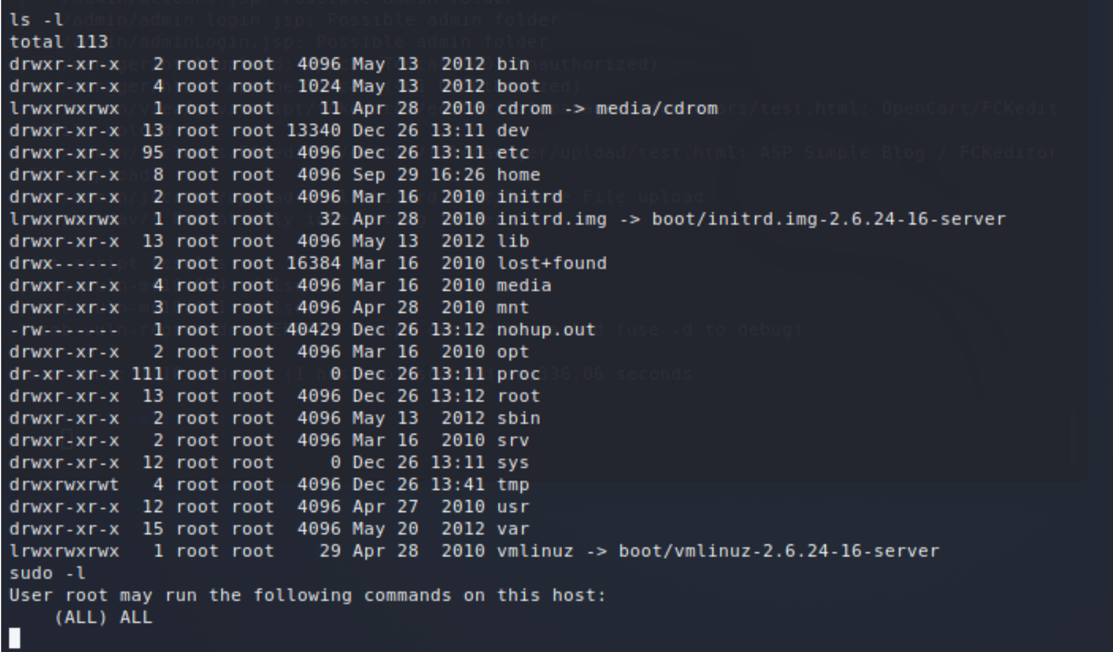
Exploit 2 Root Ctd

Slide 11
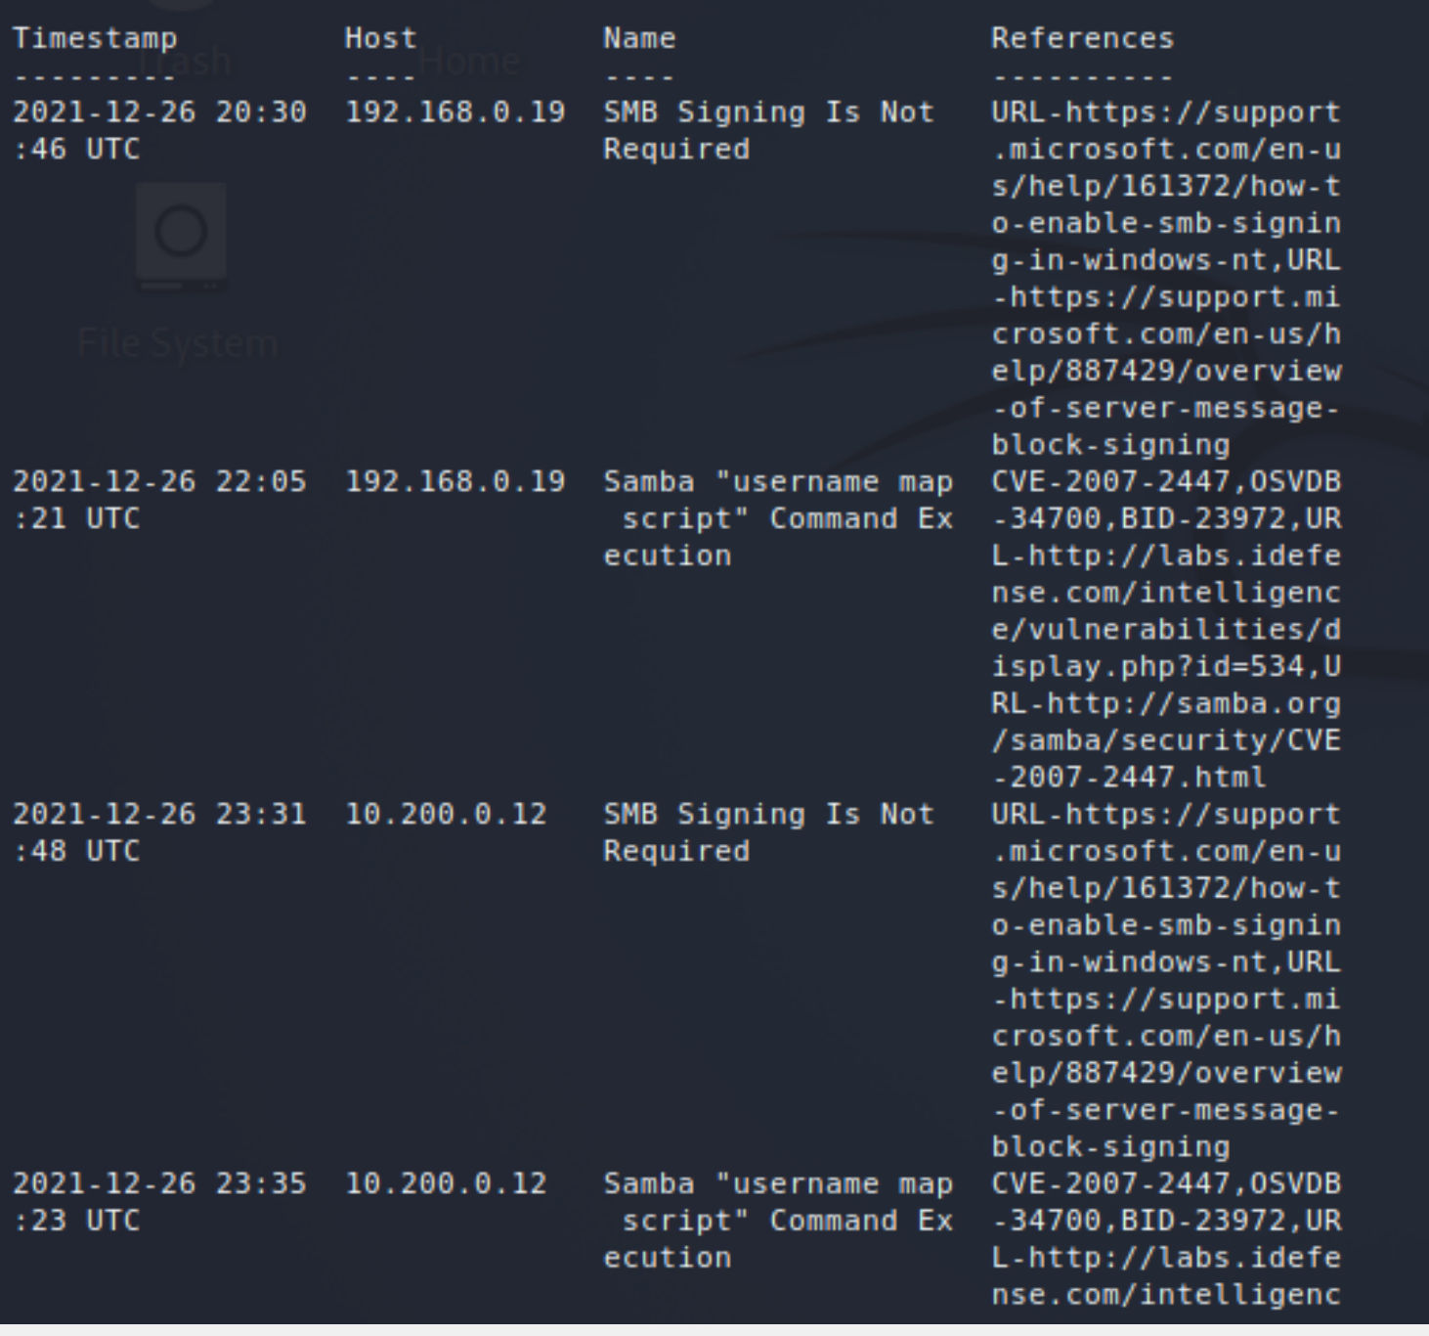
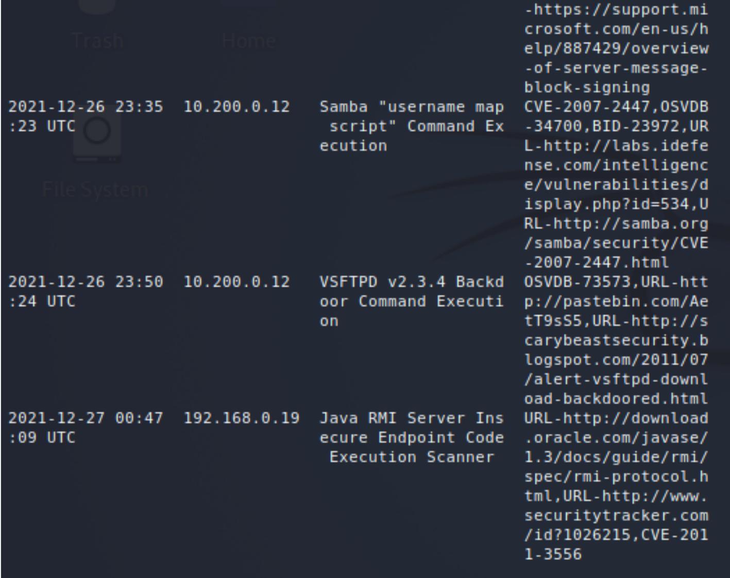
Exploits conducted

Slide 12
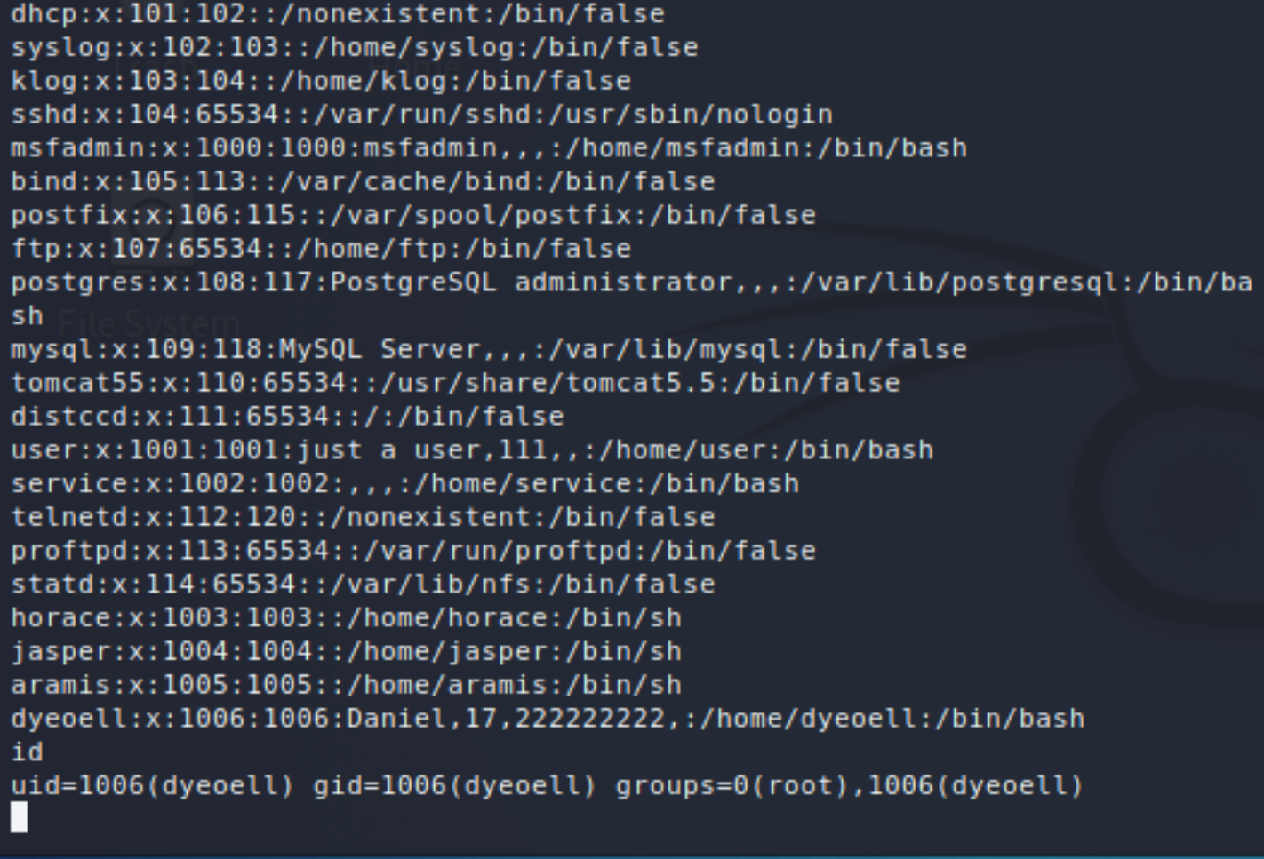
Account with Root Permission

Slide 13

Interesting Files Found

Slide 14
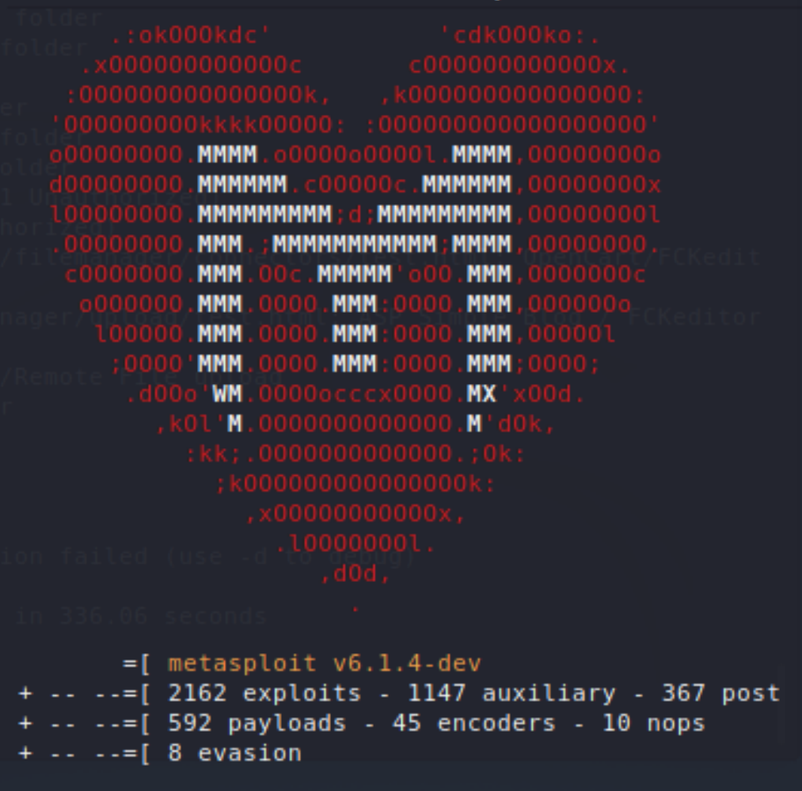
Recommendations/Closing Remarks
Securing servers are a must for all places of business
Some recommendations to be made are
Strong passwords
Regular updates
Mandated VPN’s for remote employees

